Slide 1
Garbage collection
Anju munoth

Slide 2
Garbage collection
GC--Engine that cleans up the memory of managed heap within the CLR with an internal algorithm and its own triggering engine.
Impossible to know exactly when the GC will fire
GC memory cleanup operation is named collect.
Microsoft gives us the ability to trigger the collector manually, by invoking the GC.Collect method.
Although this option is available, manually triggering the GC is something to avoid because every usage will interfere with CLR abstraction of the underlying system.

Slide 3
Garbage collection
NET's garbage collector manages the allocation and release of memory for your application.
Each time you create a new object, the common language runtime allocates memory for the object from the managed heap.
As long as address space is available in the managed heap, the runtime continues to allocate space for new objects.
However, memory is not infinite.
Eventually the garbage collector must perform a collection in order to free some memory.
GC's optimizing engine determines the best time to perform a collection, based upon the allocations being made.
When the garbage collector performs a collection, it checks for objects in the managed heap that are no longer being used by the application and performs the necessary operations to reclaim their memory.

Slide 4
Garbage collection
GC collection occurs multiple times until the process is alive and running.
Execution has the goal of freeing the memory from objects that are not in use anymore by any code block, or that are not referred by any other living object.
Any surviving object is then marked as a survivor object.
This marking phase is crucial in the GC logic.
Each survival will increment the survival counter for such an object.
First time an object is analyzed by the GC is in generation zero of its mark counter.
Multiple survivals will bring this counter to generation-1 or generation-2.
In CLR, the most unchanging objects (survived through all GCs) are marked in generation-2.

Slide 5
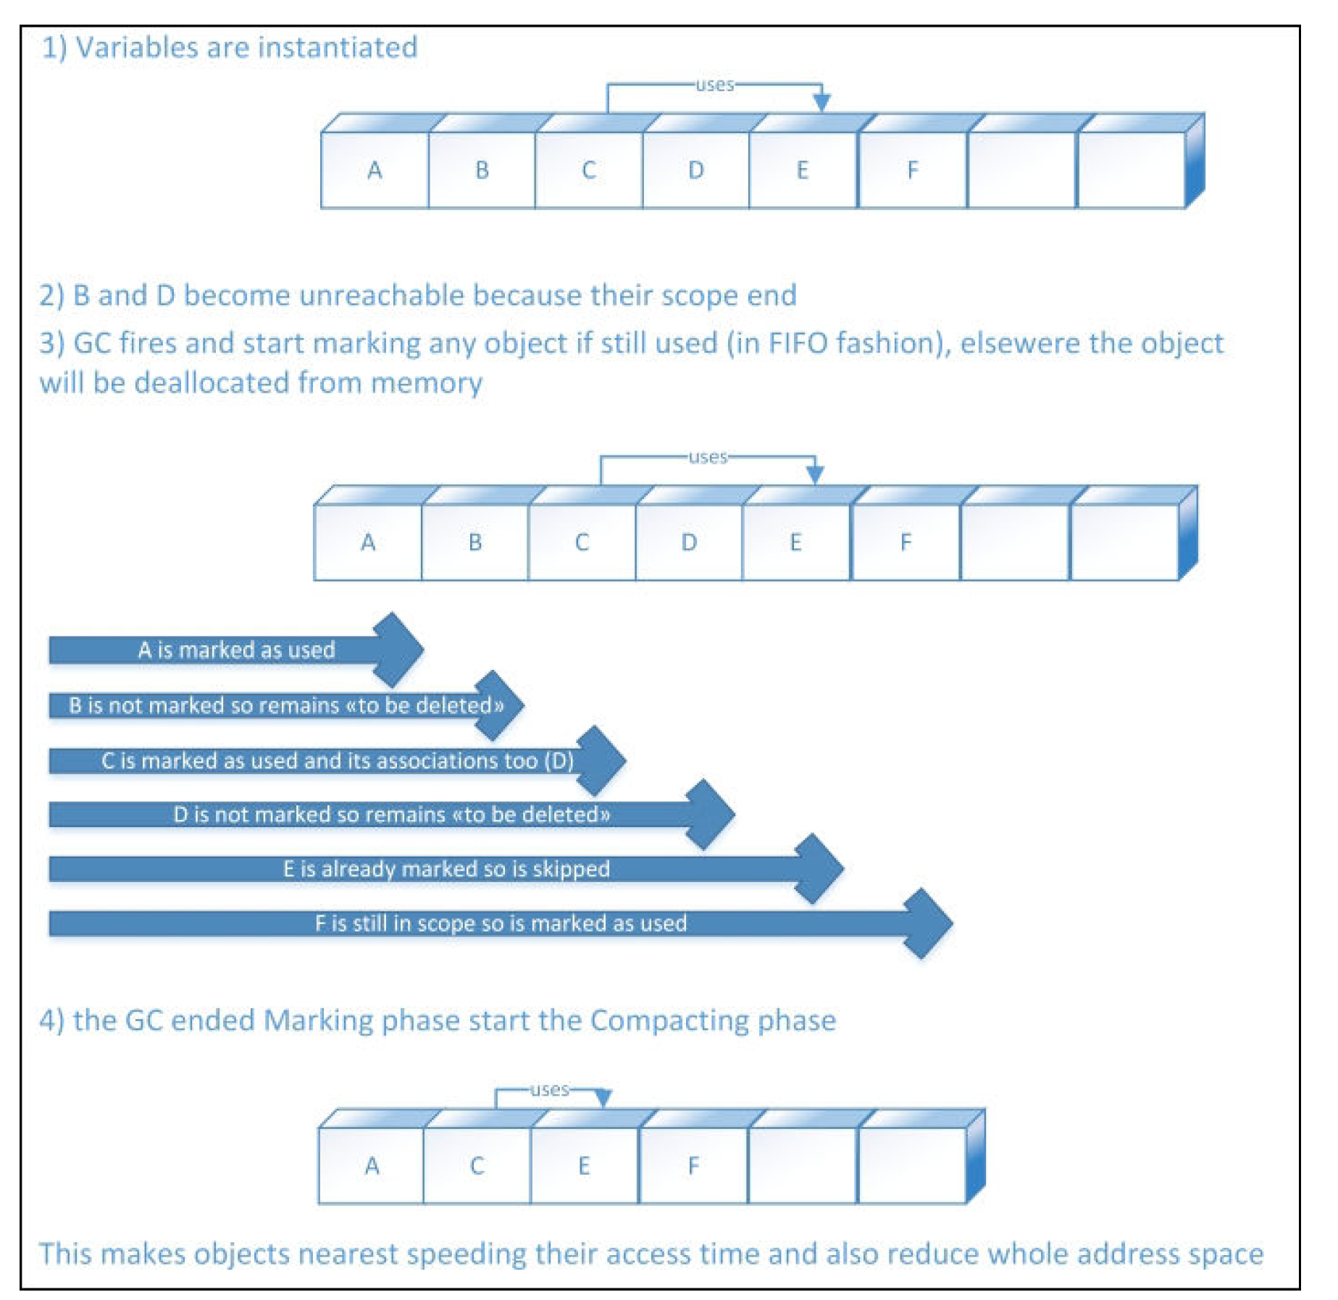

Slide 6
Garbage collection
The Garbage Collector (GC) in the Common Language Runtime (CLR) is triggered when an application needs to create new objects and exceeds a defined memory threshold. ​
Newly created objects are categorized as generation-0 (gen-0) because they are expected to be short-lived. ​
Objects that survive the marking phase are promoted to generation-1 (gen-1), indicating they are longer-lived. ​
Each generation has a size limit, and the GC typically collects objects from the generation that exceeds its limit, focusing on newer objects first. ​

Slide 7
Garbage collection
Once an object survives two collections from gen-0, GC promotes it to gen-1.
Once a gen-1 object survives four collections, it is promoted to gen-2.
Gen-2 is the less-changing generation; it is also the less-collected one.
Choice of what generation to collect is ordered from the newer (gen-0) generation up to the older (gen-2) generation.
Because of this, it may happen that if a generation always exceeds its limit, the following generations can never be collected, wasting some memory.
Obviously, a manual collection trigger will start the collection of all generations

Slide 8
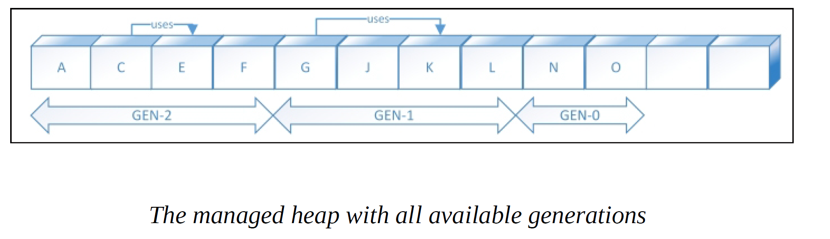
Garbage collection
Graphical representation of objects within the virtual address space of the managed heap showing different generations.
Physical fragmentation may occur, although virtual memory seems to be a straight collection of objects.

Slide 9
Size limit of each generation
When a process starts, the GC logic within the CLR assigns a size limit for each generation.
During runtime of a process, the GC increments or decrements the generation size according to the execution of the application.
This means that the GC somehow has a self-learning algorithm that tunes itself, based on how many objects it de-allocates or does not de-allocate.
Exceeding of the allocation threshold is not the only trigger for the GC to start collecting dead objects; it may also run when Windows signals low physical memory, when an AppDomain class exits (including the main one), or when the code fires GC.Collect() method.

Slide 10
Managed heap
After the CLR initializes the garbage collector, it allocates a segment of memory to store and manage objects.
This memory is called the managed heap, as opposed to a native heap in the operating system.
There's a managed heap for each managed process.
All threads in the process allocate memory for objects on the same heap.
To reserve memory, the garbage collector calls the Windows VirtualAlloc function and reserves one segment of memory at a time for managed applications.
GC also reserves segments as needed and releases segments back to the operating system (after clearing them of any objects) by calling the Windows VirtualFree function.

Slide 11
Managed heap
size of segments allocated by the garbage collector is implementation-specific and is subject to change at any time, including in periodic updates.
App should never make assumptions about or depend on a particular segment size, nor should it attempt to configure the amount of memory available for segment allocations.

Slide 12
Managed heap
Fewer objects allocated on the heap, the less work the garbage collector has to do.
When you allocate objects, don't use rounded-up values that exceed your needs, such as allocating an array of 32 bytes when you need only 15 bytes.
When a garbage collection is triggered, the garbage collector reclaims the memory that's occupied by dead objects.
Reclaiming process compacts live objects so that they're moved together, and the dead space is removed, thereby making the heap smaller.
This process ensures that objects that are allocated together stay together on the managed heap to preserve their locality.
The intrusiveness (frequency and duration) of garbage collections is the result of the volume of allocations and the amount of survived memory on the managed heap.
The heap can be considered as the accumulation of two heaps: the large object heap and the small object heap.

Slide 13
Generations
GC algorithm is based on several considerations:
It's faster to compact the memory for a portion of the managed heap than for the entire managed heap.
Newer objects have shorter lifetimes, and older objects have longer lifetimes.
Newer objects tend to be related to each other and accessed by the application around the same time.

Slide 14
Generations
Garbage collection primarily occurs with the reclamation of short-lived objects.
To optimize the performance of the garbage collector, the managed heap is divided into three generations, 0, 1, and 2, so it can handle long-lived and short-lived objects separately.
GC stores new objects in generation 0.
Objects created early in the application's lifetime that survive collections are promoted and stored in generations 1 and 2.
Because it's faster to compact a portion of the managed heap than the entire heap, this scheme allows the garbage collector to release the memory in a specific generation rather than release the memory for the entire managed heap each time it performs a collection.

Slide 15
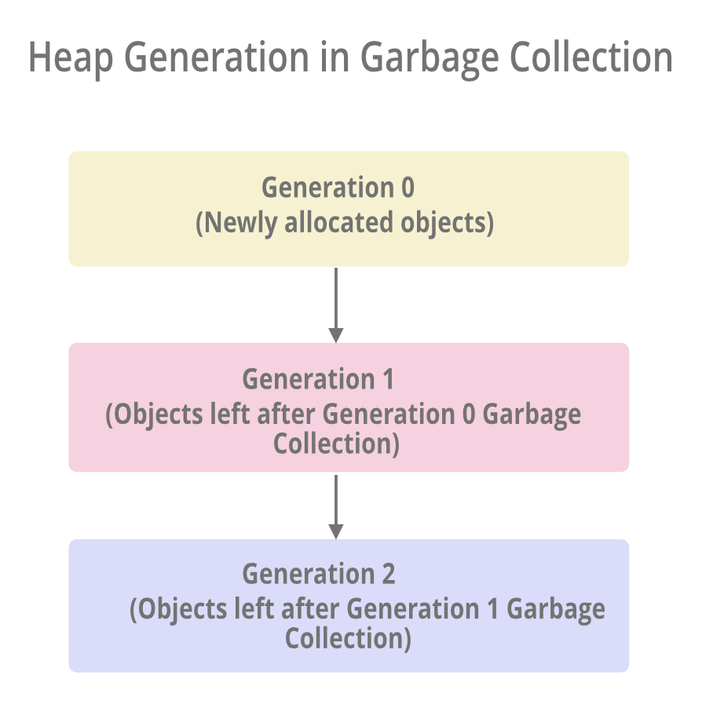

Slide 16
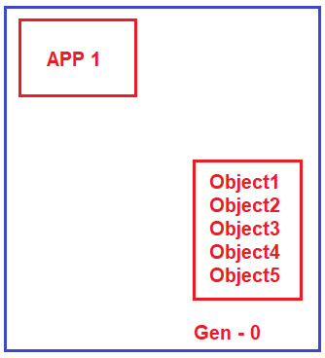
Garbage Collection Generations in .NET Framework:
Let’s say you have a simple application called App1.
As soon as the application starts, it creates 5 managed objects.
Whenever any new objects (fresh objects) are created, they are moved into a bucket called Generation 0.

Slide 17
Understanding Generation 0, 1, and 2:
Garbage Collector, runs continuously as a background process thread to check whether there are any unused managed objects so that it reclaims the memory by cleaning those objects.
Now, let’s say the application does not need two objects (Object1 and Object2).
So, the Garbage Collector will destroy these two objects (Object1 and Object2) and reclaim the memory from the Generation 0 bucket.
But the application still needs the remaining three objects (Object3, Object4, and Object5).
Garbage collector will not clean those three objects.
Garbage Collector will move those three managed objects (Object3, Object4, and Object5) to the Generation 1 bucket

Slide 18
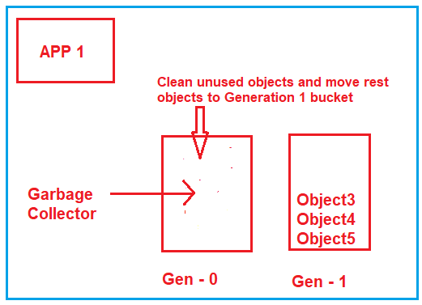
Understanding Generation 0, 1, and 2:

Slide 19
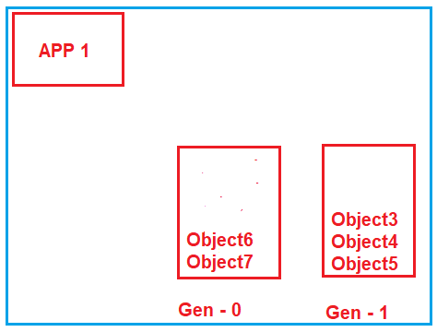
Understanding Generation 0, 1, and 2:
Let’s say your application creates two more fresh objects (Object6 and Object7).
As fresh objects, they should be created in the Generation 0 bucket,

Slide 20
Understanding Generation 0, 1, and 2:
Again, the Garbage Collector runs, and it comes to the Generation 0 bucket and checks which objects are used.
Let’s say both objects (Object6 and Object7) are unused by the application, so it will remove both objects and reclaim the memory.
Now, it goes to the Generation 1 bucket and checks which objects are unused.
Let’s say the application still needs Object4 and Object5 while object3 is not needed.
So, what Garbage Collector will do is destroy Object3, reclaim the memory, and move Object4 and Object5 to the Generation 2 bucket

Slide 21
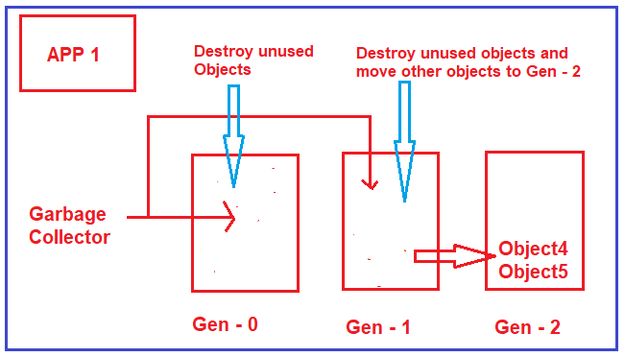
Understanding Generation 0, 1, and 2:

Slide 22
Generation 0
Youngest and contains short-lived objects.
An example of a short-lived object is a temporary variable.
Garbage collection occurs most frequently in this generation.
Newly allocated objects form a new generation of objects and are implicitly generation 0 collections.
However, if they're large objects, they go on the large object heap (LOH), which is sometimes referred to as generation 3.
Generation 3 is a physical generation that's logically collected as part of generation 2.
Most objects are reclaimed for garbage collection in generation 0 and don't survive to the next generation.
If an application attempts to create a new object when generation 0 is full, the garbage collector performs a collection to free address space for the object.
GC starts by examining the objects in generation 0 rather than all objects in the managed heap.
A collection of generation 0 alone often reclaims enough memory to enable the application to continue creating new objects.

Slide 23
Generation 1
contains short-lived objects and serves as a buffer between short-lived objects and long-lived objects.
After the garbage collector performs a collection of generation 0, it compacts the memory for the reachable objects and promotes them to generation 1.
Because objects that survive collections tend to have longer lifetimes, it makes sense to promote them to a higher generation.
GC doesn't have to reexamine the objects in generations 1 and 2 each time it performs a collection of generation 0.
If a collection of generation 0 doesn't reclaim enough memory for the application to create a new object, the garbage collector can perform a collection of generation 1 and then generation 2.
Objects in generation 1 that survive collections are promoted to generation 2.

Slide 24
Generation 2
Contains long-lived objects.
An example of a long-lived object is an object in a server application that contains static data that's live for the duration of the process.
Objects in generation 2 that survive a collection remain in generation 2 until they're determined to be unreachable in a future collection.
Objects on the large object heap (which is sometimes referred to as generation 3) are also collected in generation 2.

Slide 25
Generations
Garbage collections occur in specific generations as conditions warrant.
Collecting a generation means collecting objects in that generation and all its younger generations.
A generation 2 garbage collection is also known as a full garbage collection because it reclaims objects in all generations (that is, all objects in the managed heap).

Slide 26
Survival and promotions
Objects that aren't reclaimed in a garbage collection are known as survivors and are promoted to the next generation:
Objects that survive a generation 0 garbage collection are promoted to generation 1.
Objects that survive a generation 1 garbage collection are promoted to generation 2.
Objects that survive a generation 2 garbage collection remain in generation 2.
When GC detects that the survival rate is high in a generation, it increases the threshold of allocations for that generation.
Next collection gets a substantial size of reclaimed memory.
CLR continually balances two priorities: not letting an application's working set get too large by delaying garbage collection and not letting the garbage collection run too frequently.

Slide 27
Ephemeral generations and segments
Because objects in generations 0 and 1 are short-lived, these generations are known as the ephemeral generations.
Ephemeral generations are allocated in the memory segment that's known as the ephemeral segment.
Each new segment acquired by the garbage collector becomes the new ephemeral segment and contains the objects that survived a generation 0 garbage collection.
Old ephemeral segment becomes the new generation 2 segment.
Size of the ephemeral segment varies depending on whether a system is 32-bit or 64-bit and on the type of garbage collector it's running (workstation or server GC).

Slide 28
Default sizes of the ephemeral segment
Workstation/server GC | 32-bit | 64-bit
Workstation GC | 16 MB | 256 MB
Server GC | 64 MB | 4 GB
Server GC with > 4 logical CPUs | 32 MB | 2 GB
Server GC with > 8 logical CPUs | 16 MB | 1 GB

Slide 29
Ephemeral generations and segments
Ephemeral segment can include generation 2 objects.
Generation 2 objects can use multiple segments as many as your process requires and memory allows for.
Amount of freed memory from an ephemeral garbage collection is limited to the size of the ephemeral segment.
Amount of memory that's freed is proportional to the space that was occupied by the dead objects.

Slide 30
What happens during a garbage collection ?
Garbage collection has the following phases:
A marking phase that finds and creates a list of all live objects.
A relocating phase that updates the references to the objects that will be compacted.
A compacting phase that reclaims the space occupied by the dead objects and compacts the surviving objects.
Compacting phase moves objects that have survived a garbage collection towards the older end of the segment.
Because generation 2 collections can occupy multiple segments, objects that are promoted into generation 2 can be moved into an older segment.
Both generation 1 and generation 2 survivors can be moved to a different segment because they're promoted to generation 2.

Slide 31
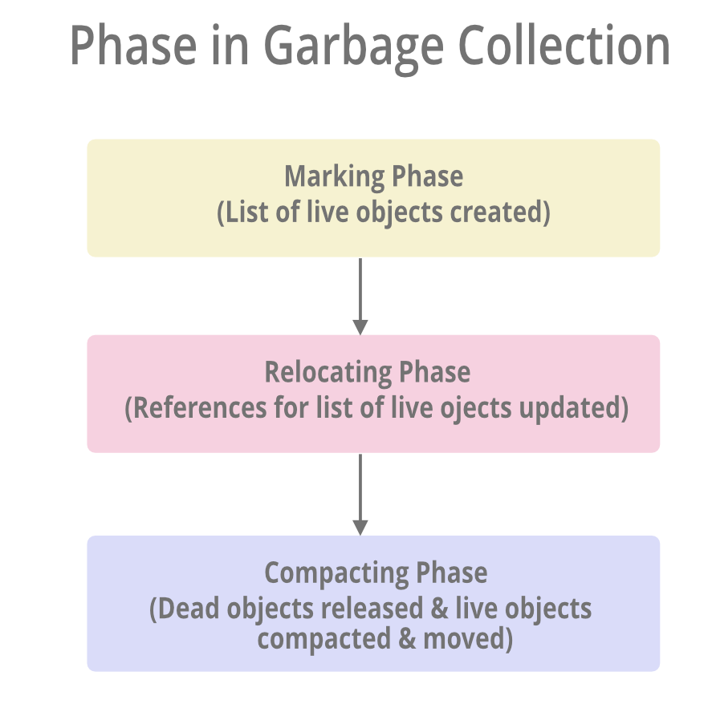

Slide 32
CLR uses a reference tracking algorithm.
This algorithm cares only about the reference type variable because these are the only ones that can refer to the object on the heap, which is known as the Root Object.
Value type contains the values directly.
When CLR starts GC, it suspends all the threads in the process to prevent them from accessing the objects and changing their state while CLR examines them.
CLR then performs the Marking phase – it walks through all the objects in the heap and looks for all the active roots to see which object they refer to.
This way CLR tracks the reference.
Any root referencing to an object on the heap makes the GC to mark that object.
When an object is marked CLR examines the root inside and marks the object they refer to and if CLR finds out that the object is already marked it does not examine the object’s field again which prevents an infinite loop from occurring in the case where we have a circular reference.
Once marking is done, CLR knows which objects must survive and which object can be deleted, then the Compacting phase kicks in.
In the compacting phase – CLR shifts the memory consumed by marked object down in the heap, compacting all the surviving objects together so that they are in continuation in the memory.
After the compacting phase is complete CLR resumes all the application’s threads and they continue to access objects as GC never happened at all.

Slide 33
1. Marking Phase
A list of all the live objects is created during the marking phase.
Done by following the references from all the root objects.
All of the objects that are not on the list of live objects are potentially deleted from the heap memory.
2. Relocating Phase
The references of all the objects that were on the list of all the live objects are updated in the relocating phase so that they point to the new location where the objects will be relocated to in the compacting phase.
GC does this by maintaining a forwarding address for each relocated object. References to the object are redirected to the new location using the forwarding address.
3. Compacting Phase
compacting phase reclaims the space occupied by the "dead" objects and compacts the surviving ("live") objects.
Does this by moving live objects into contiguous address space and freeing up fragmented memory regions.
Surviving objects are moved toward the older end of the heap memory in their original order.
Compacting phase depends on memory allocation and fragmentation patterns.
If there is sufficient memory available and the level of fragmentation is low, the compacting phase may not occur during a garbage collection cycle.

Slide 34
What happens during a garbage collection ?
garbage collector uses the following information to determine whether objects are live:
Stack roots: Stack variables provided by the just-in-time (JIT) compiler and stack walker.
JIT optimizations can lengthen or shorten regions of code within which stack variables are reported to the garbage collector.
Garbage collection handles: Handles that point to managed objects and that can be allocated by user code or the common language runtime.
Static data: Static objects in application domains that could be referencing other objects.
Each application domain keeps track of its static objects.
Before a garbage collection starts, all managed threads are suspended except for the thread that triggered the garbage collection.

Slide 35
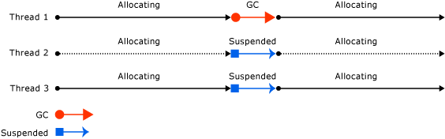
Thread that triggers a garbage collection and causes the other threads to be suspended:

Slide 36
When Does Garbage Collection Occur in .NET?
In the .NET framework, garbage collection is triggered automatically by specific events or criteria –
Low memory
An exceeded threshold
GC.Collect() method being called.

Slide 37
When Does Garbage Collection Occur in .NET?
Low Memory
The GC monitors the memory available in the system and initiates a garbage collection cycle to free resources and reclaim memory when there is high memory pressure (memory becomes scarce).
The memory pressure threshold can vary based on the system configuration and runtime environment.

Slide 38
When Does Garbage Collection Occur in .NET?
Threshold Passed
Garbage collection also occurs when the number of allocations for a generation exceeds the acceptable threshold.
Threshold for a generation is set dynamically by the garbage collector based on the application's resource requirements and memory usage patterns.
Threshold is continuously adjusted as the GC allocates objects to the generation.
A garbage collection cycle is triggered for that generation when the threshold is exceeded.

Slide 39
When Does Garbage Collection Occur in .NET?
GC.Collect() Has Been Called
The GC.Collect() method allows developers to trigger garbage collection at a specific point in their code.
Bypasses the automatic garbage collection mechanism to trigger a forced garbage collection on the entire managed heap.
Calling GC.Collect() without parameters causes all objects in all generations to be considered for garbage collection.
Passing GC.MaxGeneration as an argument to GC.Collect() results in the LOH being collected along with the rest of the managed heap.

Slide 40
Large object heap
.NET garbage collector (GC) divides objects up into small and large objects.
When an object is large, some of its attributes become more significant than if the object is small.
For instance, compacting it—that is, copying it in memory elsewhere on the heap—can be expensive.
Because of this, the garbage collector places large objects on the large object heap (LOH).

Slide 41
Large object heap
CLR categorizes objects into two sizes: small (less than 85,000 bytes) and large (equal to or greater than 85,000 bytes). ​
Large objects are stored in a special heap called the Large Object Heap (LOH). ​
While the managed heap handles both small and large objects, the LOH has limitations due to the size of its objects. ​
For small objects, the Garbage Collector (GC) prevents issues like memory corruption, fragmentation, and leaks by storing each object only once. ​
For large objects in the LOH, the GC skips the compacting phase to reduce thread suspension and avoid CPU-intensive tasks like moving large objects in memory. ​
This improves collection speed but does not optimize memory usage, as unused space between objects is not reclaimed—only unused space at the edges is released. ​

Slide 42
Large object heap
Newly allocated objects form a new generation of objects and are implicitly generation 0 collections.
Large objects --go on the large object heap (LOH), which is sometimes referred to as generation 3.
Generation 3 is a physical generation that's logically collected as part of generation 2.
Large objects belong to generation 2 because they are collected only during a generation 2 collection.
When a generation is collected, all its younger generation(s) are also collected.
For example, when a generation 1 GC happens, both generation 1 and 0 are collected. And when a generation 2 GC happens, the whole heap is collected.
For this reason, a generation 2 GC is also called a full GC.

Slide 43
Large object heap
Great limitation to dealing with using LOH is trying to reduce the collection time.
All objects within LOH are marked as gen-2.
This means that CLR expects that objects always live long.
Causes a great impact on application performance if their real usage is short-lived because the great size will easily exceed the gen-2 size limit, starting the collection phase of such an internal, and usually never-changing, heap area.
Ordinarily, the large object heap (LOH) isn't compacted because copying large objects imposes a performance penalty.
However, in .NET Core and in .NET Framework 4.5.1 and later, you can use the GCSettings.LargeObjectHeapCompactionMode property to compact the large object heap on demand.
LOH is automatically compacted when a hard limit is set by specifying either:
A memory limit on a container.
The GCHeapHardLimit or GCHeapHardLimitPercent runtime configuration options.

Slide 44
Benefits
GC provides the following benefits:
Frees developers from having to manually release memory.
Allocates objects on the managed heap efficiently.
Reclaims objects that are no longer being used, clears their memory, and keeps the memory available for future allocations.
Managed objects automatically get clean content to start with, so their constructors don't have to initialize every data field.
Provides memory safety by making sure that an object can't use for itself the memory allocated for another object.

Slide 45
Collection tuning
By invoking the GC.Collect method (or when the CLR responds to the Windows low-memory event), it is possible to force start the collection algorithm of any generation.
Although this may happen (suggest never invoking it manually), GC usually works in a triggered fashion, trying to balance the lowest application performance impact with the needed memory cleanup.

Slide 46
Garbage collection
Garbage collection is divided into two different algorithms that fulfill different application needs.
Can choose which garbage collection type to use within our application only once in the application configuration file (orWeb Configuration File), under the runtime node, where we can switch from the workstation collection (default) to the server collection:
<runtime>
<gcServer enabled="true" /> <!-- enables Server mode -->
</runtime>
When the GC works in the workstation mode (default), the CLR tries to balance the overall execution time of the collection with a few resources, by using a single thread at normal priority to analyze and eventually release the unused memory blocks.
When the GC works in server mode (available only for multicore systems),it creates a thread per CPU core and divides the collection work across those threads that will clean up all managed heaps and LOHs related to all application threads executing on the same CPU core.

Slide 47
Workstation garbage collection (GC)
Designed for client apps.
Default GC flavor for standalone apps.
For hosted apps, for example, those hosted by ASP.NET, the host determines the default GC flavor.
Workstation garbage collection can be concurrent or non-concurrent.
Concurrent (or background) garbage collection enables managed threads to continue operations during a garbage collection.
Background garbage collection replaces concurrent garbage collection in .NET Framework 4 and later versions.

Slide 48
Performance considerations -- Workstation GC
Collection occurs on the user thread that triggered the garbage collection and remains at the same priority.
Because user threads typically run at normal priority, the garbage collector (which runs on a normal priority thread) must compete with other threads for CPU time.
Threads that run native code are not suspended on either server or workstation garbage collection.
Workstation garbage collection is always used on a computer that has only one logical CPU, regardless of the configuration setting.

Slide 49
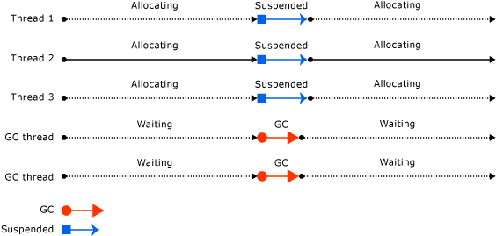
Illustration shows the dedicated threads that perform the garbage collection on a server

Slide 50
Server garbage collection
Intended for server applications that need high throughput and scalability.
In .NET Core, server garbage collection can be non-concurrent or background.
In .NET Framework 4.5 and later versions, server garbage collection can be non-concurrent or background.
In .NET Framework 4 and previous versions, server garbage collection is non-concurrent.

Slide 51
Server collection
Using server collection,
Can definitely boost memory cleanup throughput by using multiple cores and avoiding a single thread crossing all CPU cores available.
Drawback --Higher resource usage because of the increased thread count.
Server collection should be configured only for applications that are specific to the server side (such as a database or web server), preferring single-application servers.

Slide 52
Performance considerations -- Server GC
Collection occurs on multiple dedicated threads.
On Windows, these threads run at THREAD_PRIORITY_HIGHEST priority level.
A heap and a dedicated thread to perform garbage collection are provided for each logical CPU, and the heaps are collected at the same time.
Each heap contains a small object heap and a large object heap, and all heaps can be accessed by user code.
Objects on different heaps can refer to each other.
Because multiple garbage collection threads work together, server garbage collection is faster than workstation garbage collection on the same size heap.

Slide 53
Performance considerations -- Server GC
Server garbage collection often has larger size segments.
However, this is only a generalization: segment size is implementation-specific and is subject to change.
Don't make assumptions about the size of segments allocated by the garbage collector when tuning your app.
Server garbage collection can be resource-intensive.
For example, imagine that there are 12 processes that use server GC running on a computer that has four logical CPUs.
If all the processes happen to collect garbage at the same time, they would interfere with each other, as there would be 12 threads scheduled on the same logical CPU.
If the processes are active, it's not a good idea to have them all use server GC.

Slide 54
Performance considerations -- Server GC or workstation GC
If you're running hundreds of instances of an application, consider using workstation garbage collection with concurrent garbage collection disabled.
Will result in less context switching, which can improve performance.

Slide 55
Background garbage collection
In background garbage collection (GC), ephemeral generations (0 and 1) are collected as needed while the collection of generation 2 is in progress.
Background garbage collection is performed on one or more dedicated threads, depending on whether it's workstation or server GC, and applies only to generation 2 collections.
Background garbage collection is enabled by default.
Can be enabled or disabled with the gcConcurrent configuration setting in .NET Framework apps or the System.GC.Concurrent setting in .NET Core and .NET 5 and later apps.

Slide 56
Background garbage collection
A collection on ephemeral generations during background garbage collection is known as foreground garbage collection.
When foreground garbage collections occur, all managed threads are suspended.
When background garbage collection is in progress and you've allocated enough objects in generation 0, the CLR performs a generation 0 or generation 1 foreground garbage collection.
The dedicated background garbage collection thread checks at frequent safe points to determine whether there is a request for foreground garbage collection.
If there is, the background collection suspends itself so that foreground garbage collection can occur.
After the foreground garbage collection is completed, the dedicated background garbage collection threads and user threads resume.

Slide 57
Background garbage collection
Background garbage collection removes allocation restrictions imposed by concurrent garbage collection, because ephemeral garbage collections can occur during background garbage collection.
Background garbage collection can remove dead objects in ephemeral generations.
Can also expand the heap if needed during a generation 1 garbage collection.

Slide 58
Background workstation vs. server GC
Starting with .NET Framework 4.5, background garbage collection is available for server GC.
Background GC is the default mode for server garbage collection.
Background server garbage collection functions similarly to background workstation garbage collection, but there are a few differences:
Background workstation garbage collection uses one dedicated background garbage collection thread, whereas background server garbage collection uses multiple threads.
Typically, there's a dedicated thread for each logical processor.
Unlike the workstation background garbage collection thread, the background server GC threads do not time out.

Slide 59
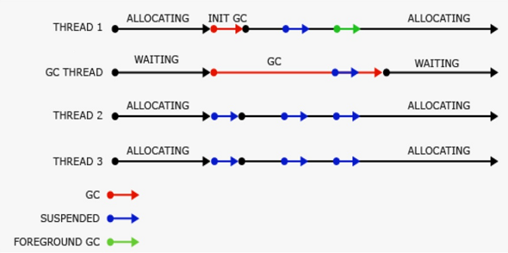
background workstation garbage collection performed on a separate, dedicated thread

Slide 60
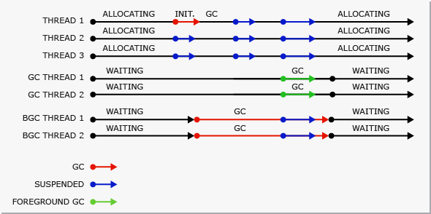
background server garbage collection performed on separate, dedicated threads

Slide 61
Concurrent garbage collection
Concurrent GC is applicable only to the following
.NET Framework 3.5 and earlier for workstation garbage collection
.NET Framework 4 and earlier for server garbage collection
Concurrent garbage is replaced by background garbage collection in later versions.

Slide 62
Concurrent garbage collection
In workstation or server garbage collection, you can enable concurrent garbage collection, which enables threads to run concurrently with a dedicated thread that performs the garbage collection for most of the duration of the collection.
This option affects only garbage collections in generation 2; generations 0 and 1 are always non-concurrent because they finish fast.
Concurrent garbage collection enables interactive applications to be more responsive by minimizing pauses for a collection.
Managed threads can continue to run most of the time while the concurrent garbage collection thread is running.
This design results in shorter pauses while a garbage collection is occurring.
Concurrent garbage collection is performed on a dedicated thread.
By default, the CLR runs workstation garbage collection with concurrent garbage collection enabled on both single-processor and multi-processor computers.

Slide 63
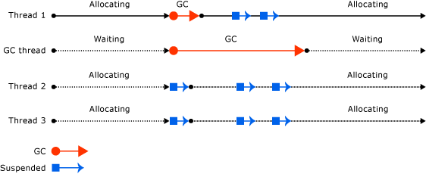
concurrent garbage collection performed on a separate dedicated thread

Slide 64
Summary
Each approach to garbage collection is available in three different variations:
Non-concurrent garbage collection suspends all non-garbage-collection threads for the full duration of the garbage collection, effectively pausing the application for that time.
Concurrent garbage collection allows user threads to run for the most of generation 2 garbage collection. As long as there is still free space in the managed heap for new allocations, user threads are allowed to run and create new objects. This results in a shorter garbage collection pause, at the cost of higher CPU and memory requirements.
Background garbage collection is the replacement for concurrent garbage collection. It was introduced in .NET framework 4 for workstation garbage collection, and in .NET framework 4.5 for server garbage collection. It is similar to concurrent garbage collection but allows generation 0 and generation 1 garbage collection to interrupt an ongoing generation 2 garbage collection and temporarily block program execution. After generation 0 and generation 1 garbage collection is completed, both the program execution as well as the generation 2 garbage collection, continues. This even further shortens the time the program execution is paused because of garbage collection.

Slide 65
Configuration settings
By default, concurrent or background garbage collection will be used (depending on the .NET framework version), but this can be changed with a setting in the application configuration file:
<?xml version="1.0" encoding="utf-8"?>
<configuration>
<runtime>
<gcConcurrent enabled="false"></gcConcurrent>
</runtime>
</configuration>

Slide 66
Configuration settings in .NET Core
The same two garbage collection configuration options are available .NET Core.
Since there’s no application configuration XML file in .NET Core, the settings are placed in the runtime configuration JSON file (named AssemblyName.runtimeconfig.json) instead:
{
"runtimeOptions": {
"configProperties": {
"System.GC.Concurrent": false,
"System.GC.Server": true
}
}
}

Slide 67
Configuration settings in .NET Core
Typically, this file is not edited manually.
Its contents are generated at compile time based on the MSBuild project (.csproj) file.
To configure the garbage collector, you can set the following properties in the project file:
<PropertyGroup>
<ServerGarbageCollection>true</ServerGarbageCollection>
<ConcurrentGarbageCollection>false</ConcurrentGarbageCollection>
</PropertyGroup>

Slide 68
LatencyMode property
Available to optimize collection intrusiveness and triggering.
Default collect mode is the interactive (or concurrent) mode.
Collection marking phase works in a background thread (or multiple threads, if using server collection) and only the memory release and compact works by suspending all application threads.
Mode is maybe the most balanced one, trying to have good throughput in memory release without consuming too many resources.
Opposite is the batch mode (or called as the non-concurrent mode).
Mode is configurable within the configuration file
can be configured by disabling the concurrent mode
<runtime>
<gcConcurrent enabled="false"/> <!-- enables Batch mode -->
</runtime>

Slide 69
LatencyMode property
Batch mode is the most powerful in terms of throughput of memory release because it simply suspends all application thread execution and releases all unused memory.
Obviously, this choice can break application latency because an application request must await the completion of the collection.
Other LatencyMode configurations are available only at runtime by setting the GCSettings.LatencyMode property with a value of the GCLatencyMode enum that contains the batch and interactive values, plus the LowLatency, SustainedLowLatency and NoGCRegion values.

Slide 70
LatencyMode property -- LowLatency
By choosing the LowLatency mode (available only for workstation collection), gen-2 collection is suspended completely, while gen-0 and gen-1 are still collected.
Option should be used only for short periods when we need a very low interference of the GC during a critical job; otherwise, an OutOfMemoryException error may occur.
When manually triggering the collector with the related GC.Collect method, or when a system is low on memory, a gen-2 collection will occur, although in the LowLatency mode.
One of the best benefit when using the LowLatency mode is increase in application responsiveness because of the collection of only small items.
GC itself uses resources minimally, but in the meanwhile, the process can still consume lots of memory because of the inability to collect long visibility objects from gen-2.

Slide 71
LatencyMode property -- LowLatency
LowLatency mode is configurable, as shown in the following code:
var previousTiming = GCSettings.LatencyMode;
try
{
//switch to LowLatency mode
GCSettings.LatencyMode = GCLatencyMode.LowLatency;
//your code
//never use large short-living objects here
}
finally
{
GCSettings.LatencyMode = previousTiming;
}

Slide 72
LatencyMode property -- SustainedLowLatency
SustainedLowLatency mode is similar to an optimized interactive mode that tries to have more memory retention than the interactive mode actually uses.
A complete collection usually occurs only when Windows signals a low-on-memory state.
Contrary to the LowLatency mode, which must be used only for a very short duration, the SustainedLowLatency mode can be chosen as an interactive or batch mode without the occurrence of an out-ofmemory state.
Obvious that a system with more physical RAM is the best candidate for such a configuration

Slide 73
LatencyMode property --NoGCRegion.
extreme purpose of disabling the whole garbage collection process.
Choice gives all computational resources to application code, disabling any GC threads.
Such behavior can easily create an OutOfMemoryException condition, and its usage should occur only for very short time periods in extreme cases.
Enumeration value (GCSettings.LatencyMode) is in read-only.
Cannot write the GCSettings.LatencyMode property specifying the NoGCRegion value.
Instead, we need to signal such a critical section by invoking a couple of methods, one to enter and one to exit this section.

Slide 74
LatencyMode property --NoGCRegion.
try
{
var neededMemoryAmount = 1000000000;
//asks GC to stop collecting
GC.TryStartNoGCRegion(neededMemoryAmount);
//do your critical stuffs
}
catch (Exception)
{ //handle the exception }
finally
{
//resume previous collect mode
GC.EndNoGCRegion();
}

Slide 75
Garbage Collection - Best Practices
When a multithreaded application creating a lot of objects is running on a computer which doesn’t host many other processes, switch from workstation to server garbage collection.
The application will benefit from shorter pauses while not negatively affecting other applications with high priority garbage collection threads.
Although garbage collection can be triggered manually by calling GC.Collect, it should usually be avoided as the CLR heuristics will be able to better schedule garbage collection based on all the information available.
Probably the only use case when manual garbage collection could make sense would be when in a short time, a lot of objects were not in use, and the application can afford a deterministic garbage collection pause without negatively affecting the user.
Allocation of large objects with short life time should be avoided as much as possible.
Will take a long time before they are released because they are immediately placed in generation 2 and they will make the large object heap fragmented because it is not compacted.
If possible, avoid allocating large numbers of objects with short lifetimes and try to reuse the objects instead.
This will avoid frequent triggering of generation 0 garbage collection, which causes pauses in program execution.

Slide 76
Performance Issues in Garbage Collection and Their Solutions
Out-of-Memory Exception
An out-of-memory exception occurs when an application has run out of available memory resources and cannot allocate additional memory to new objects and data structures.
Frequent out-of-memory exceptions can cause increased garbage collection cycles and increased CPU usage, leading to application performance degradation.
Solution :
To resolve this issue, you can use tools such as WinDbg or the Visual Studio debugger to help you determine if the exception is managed or unmanaged, identify and fix memory leaks in the application, and find objects that are not being released properly.
The Performance tab in Windows Task Manager can also show you if you are running low on physical memory.

Slide 77
Performance Issues in Garbage Collection and Their Solutions
Generation 0 Is Too Big
A large Generation 0 collection requires more time and resources to scan for live objects.
This results in longer pauses for garbage collection and increased CPU usage, which can degrade performance and reduce application responsiveness.
Generation 0 performance issues can be resolved by adjusting the thresholds for the collection to help control its size and frequency based on the application's memory usage patterns and performance requirements.
Can also use profiling and performance monitoring tools to identify when the Generation 0 collection is becoming excessively large, analyze the causes, and perform targeted optimizations to minimize the impact.

Slide 78
Performance Issues in Garbage Collection and Their Solutions
CPU and Memory Usage during Garbage Collection Is High
When the number of collections is too frequent or the collection process takes too long, it can cause high CPU or memory usage by the GC, increased memory fragmentation, and a drop in application performance.
Using the CPU Usage performance tool, you can see the CPU time and percentage spent executing code in a .NET application to identify high CPU usage and identify bottlenecks to target for optimization.
With the Memory Usage diagnostic tool, you can also take snapshots of the managed and native memory heaps to find memory leaks and inefficiencies and understand how objects in the application are using memory.
Both of these tools (and others) are available in the Diagnostic Tools window or during a debugging session in Visual Studio.

Slide 79
Performance Issues in Garbage Collection and Their Solutions
Managed Heap Is Fragmented
Garbage collection performance issues can also arise if the managed heap becomes too fragmented.
Can lead to increased memory allocations and more frequent garbage collection cycles, resulting in performance degradation.
Triggering garbage collection with compaction using GC.Collect() will rearrange objects and merge free memory blocks.
Continuously monitoring memory usage patterns and optimizing memory-intensive code sections can also help you identify and address memory leaks or inefficient memory usage patterns that are contributing to fragmentation.

Slide 80
Performance Issues in Garbage Collection and Their Solutions

Slide 81
Performance Issues in Garbage Collection and Their Solutions

Slide 82
Performance Issues in Garbage Collection and Their Solutions

Slide 83
Performance Issues in Garbage Collection and Their Solutions

